Slide 1

OLA TRIPS ANALYSIS

Slide 2

This database consists of 5 tables
Trips
Trips_details
Loc
Duration
Payment

Slide 3
Table Trips consists of columns:
Tripid - Contains id of the trip
Faremethod - Contains id of the method used for payment
Fare - Contains the fare data given by customer for the trip
Loc_from - Contains the location from where trip was originated.
Loc_to - Contains the location from where trip was ended.
Driverid - Contains id of the driver.
Custid - Contains id of the customer
Distance - Conatins the data for Distance.
Duration - Conatins the id for Duration.

Slide 4
Table trips_deatils consists of columns:
Tripid- Contains the id of the trip.
Loc_from - Contains the location from where trip originated.
Searches - Does the customer entered start and end location(0/1)
Searches_got_estimate - Does the customer checked the fare (0/1)
Searches_for_quotes - Does the customer search for the driver(0/1)
Searches_got_quotes- Does the customer got the driver(0/1)
Customer_not_cancelled - Does the customer not cancelled the ride(0/1)
Driver_not_cancelled - Does the driver not cancelled the ride(0/1)
Otp_entered - Does the otp was entered (0/1)
End_ride - Does the ride ended(0/1)

Slide 5
Table Loc consists of columns:
Id - Contains the id of the location
Assembly - Contains the name of the location
Table Duration consists of columns:
Id - Contains the id of the duration
Duration - Contains duration interval such as 0-1 or 13-14
Table Payment consists of columns:
Id- Contains the id of the payment method
Method- Contains the name of payment method such as Cash.

Slide 6
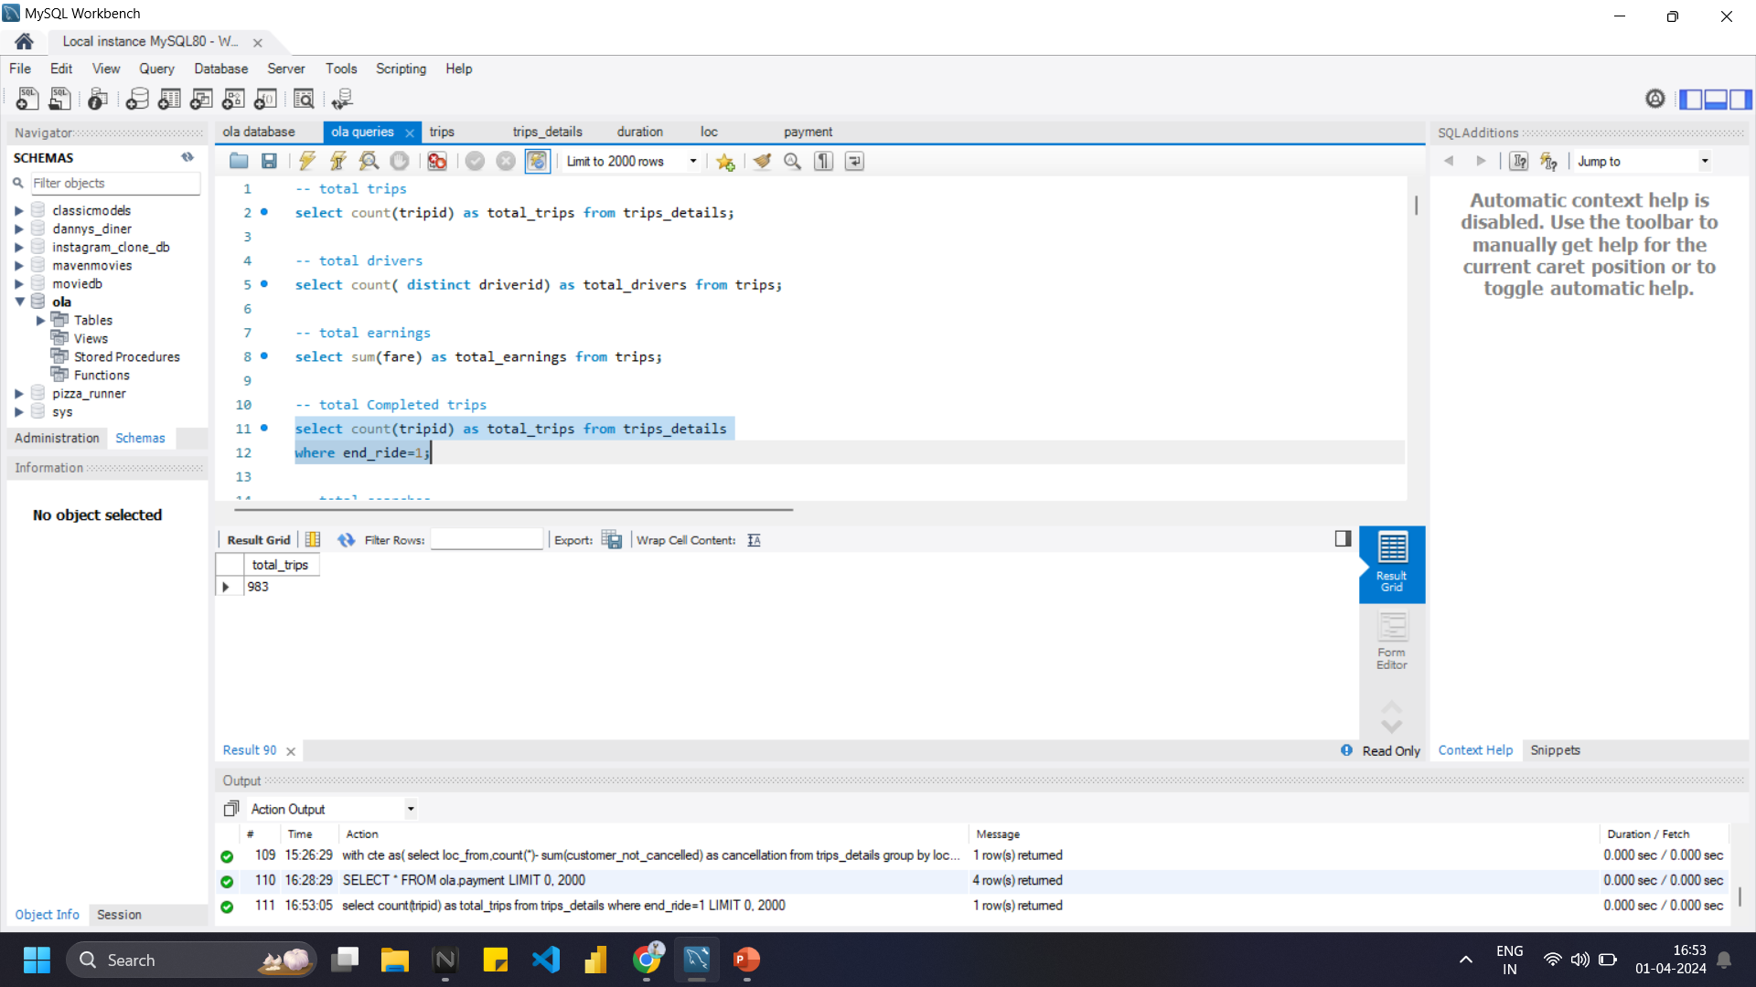
Write a SQL Query for total Completed trips
Ans:
select count(tripid) as total_trips from trips_details
where end_ride=1;

Slide 7
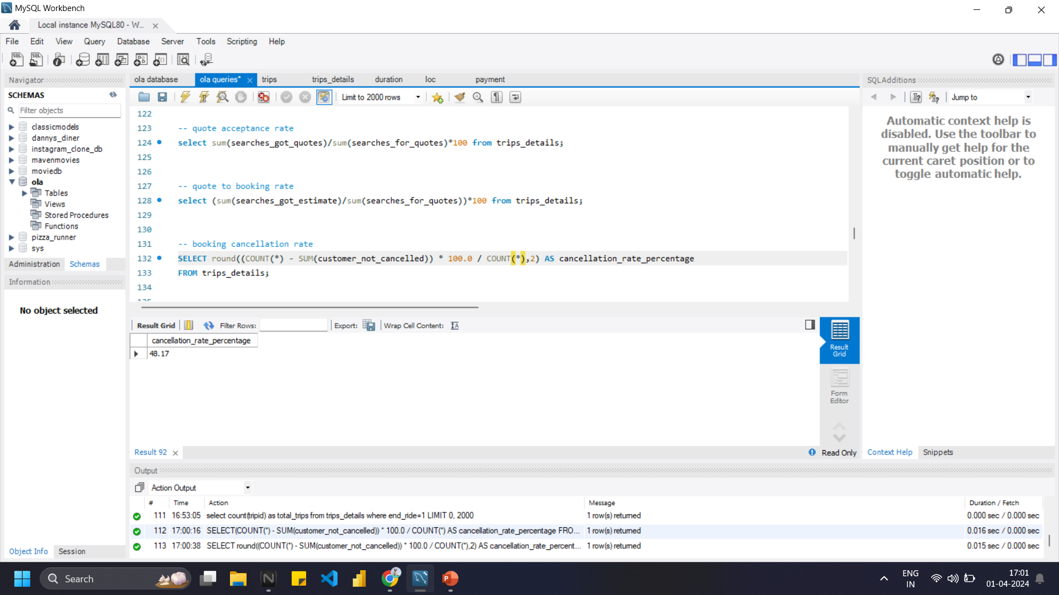
Write a SQL Query for booking cancellation rate
Ans:
select
Round((count(*) - sum(customer_not_cancelled)) * 100 / count(*),2) as cancellation_rate_percentage
from trips_details;

Slide 8
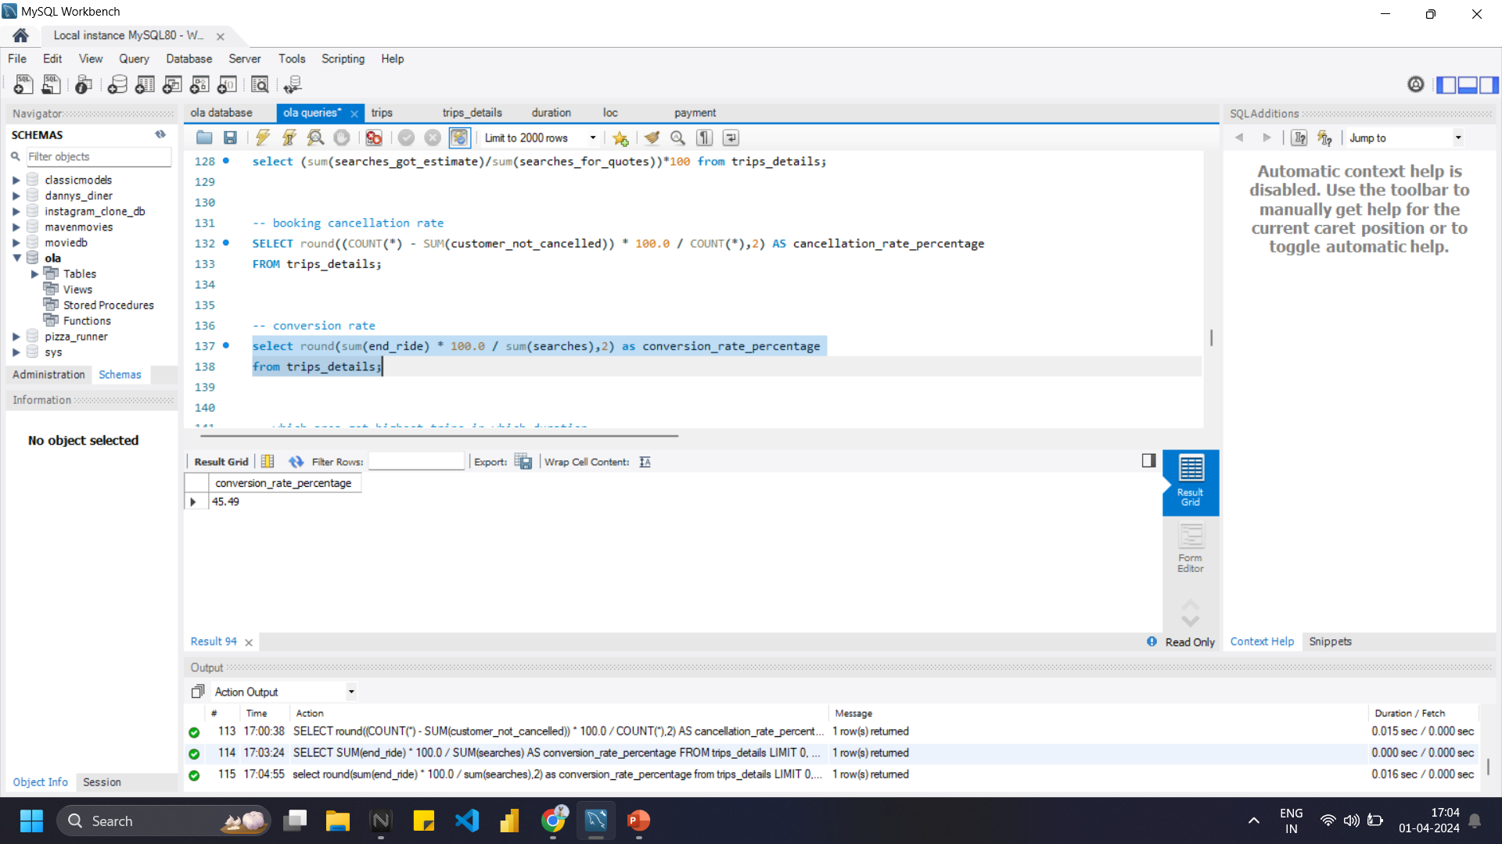
Write a SQL Query for Conversion rate
Ans:
select
round(sum(end_ride) * 100.0 / sum(searches),2) as conversion_rate_percentage
from trips_details;

Slide 9
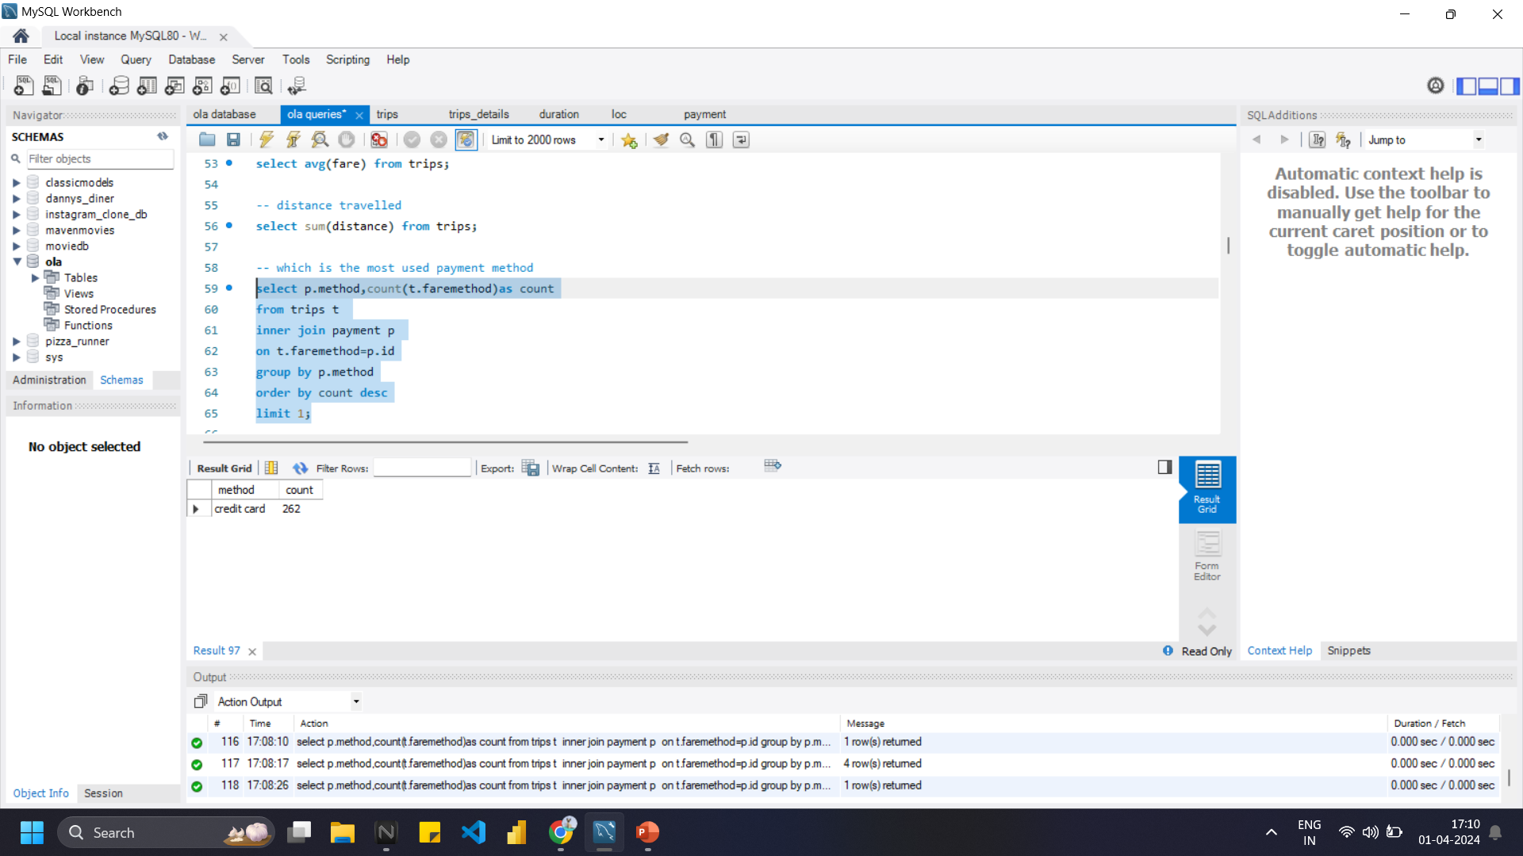
Write a SQL Query for ,Which is the most used payment method
Ans:
select p.method,count(t.faremethod) as count
from trips t
inner join payment p on t.faremethod=p.id
group by p.method
order by count desc
limit 1;

Slide 10
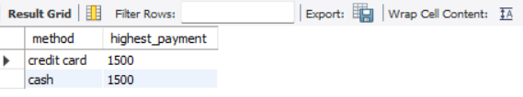
Write a SQL Query for the highest payment was made through which method
Ans:
with cte as (
select p.method,t.fare as highest_payment,
dense_rank() over(order by t.fare desc) as rnk
from trips t
inner join payment p on t.faremethod=p.id
order by t.fare desc)
select method, highest_payment from cte where rnk=1;

Slide 11
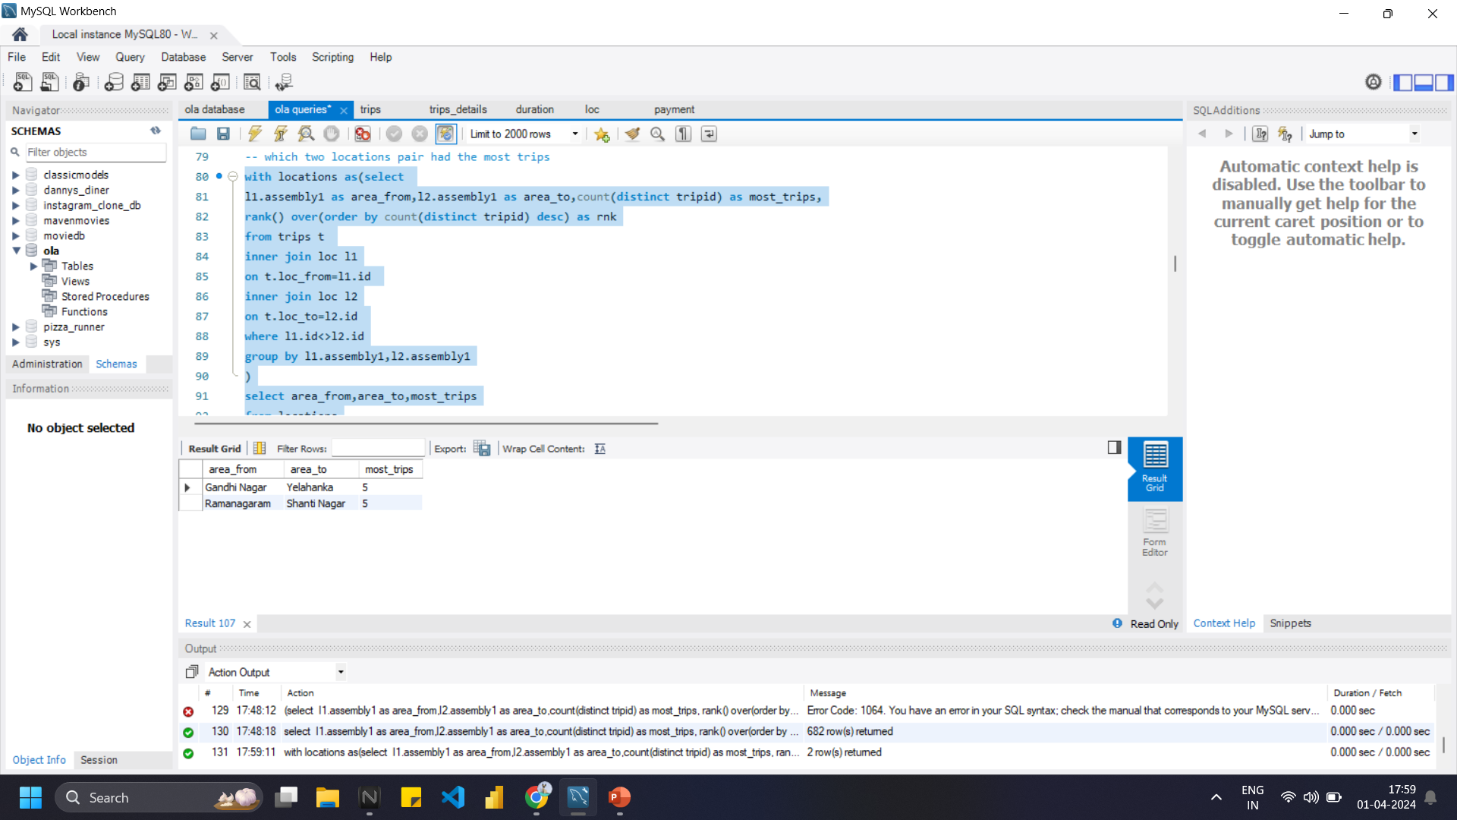
Write a SQL Query for ,Which two locations pair had the most trips
Ans: with locations as
(select l1.assembly1 as area_from,
l2.assembly1 as area_to,
count(distinct tripid) as most_trips,
rank() over(order by count(distinct tripid) desc) as rnk
from trips t
inner join loc l1 on t.loc_from=l1.id
inner join loc l2 on t.loc_to=l2.id
where l1.id<>l2.id
group by l1.assembly1,l2.assembly1)
select area_from,area_to,most_trips from locations
where rnk<3;

Slide 12
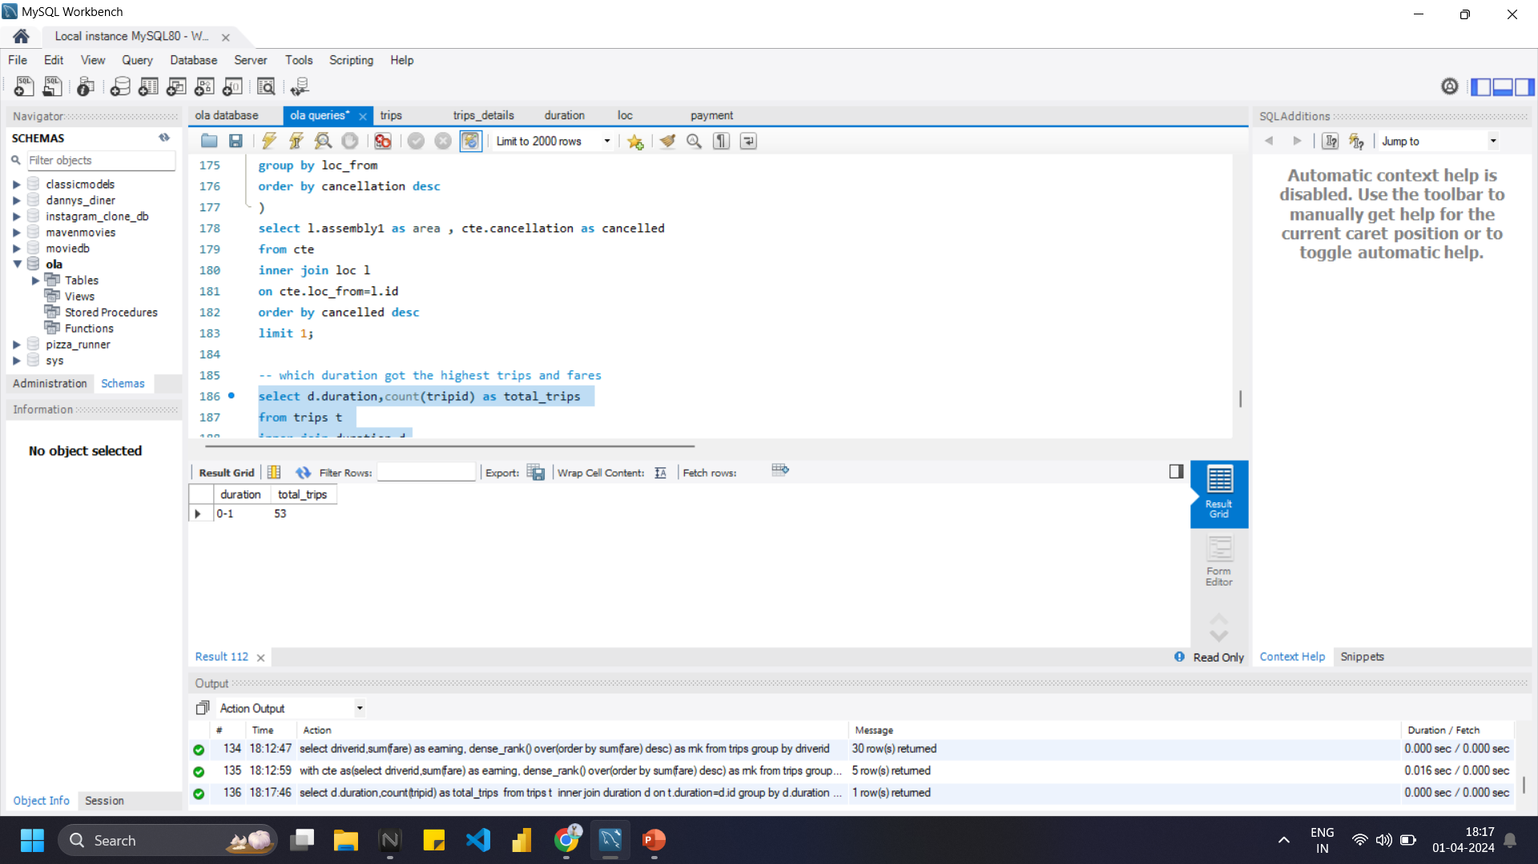
Write a SQL Query for which duration got the highest trips and fares
Ans:
select d.duration,count(tripid) as total_trips
from trips t
inner join duration d
on t.duration=d.id
group by d.duration
order by total_trips desc
limit 1;

Slide 13
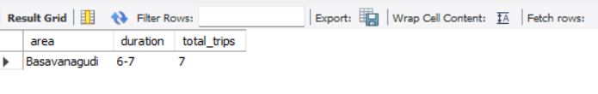
Write a SQL Query for ,which area got highest trips in which duration
Ans:
select l.assembly1 as area ,
d.duration, count(t.tripid) as total_trips
from trips t
inner join loc l on t.loc_from=l.id
inner join duration d on t.duration=d.id
group by l.assembly1,d.duration
order by total_trips desc
limit 1;

Slide 14
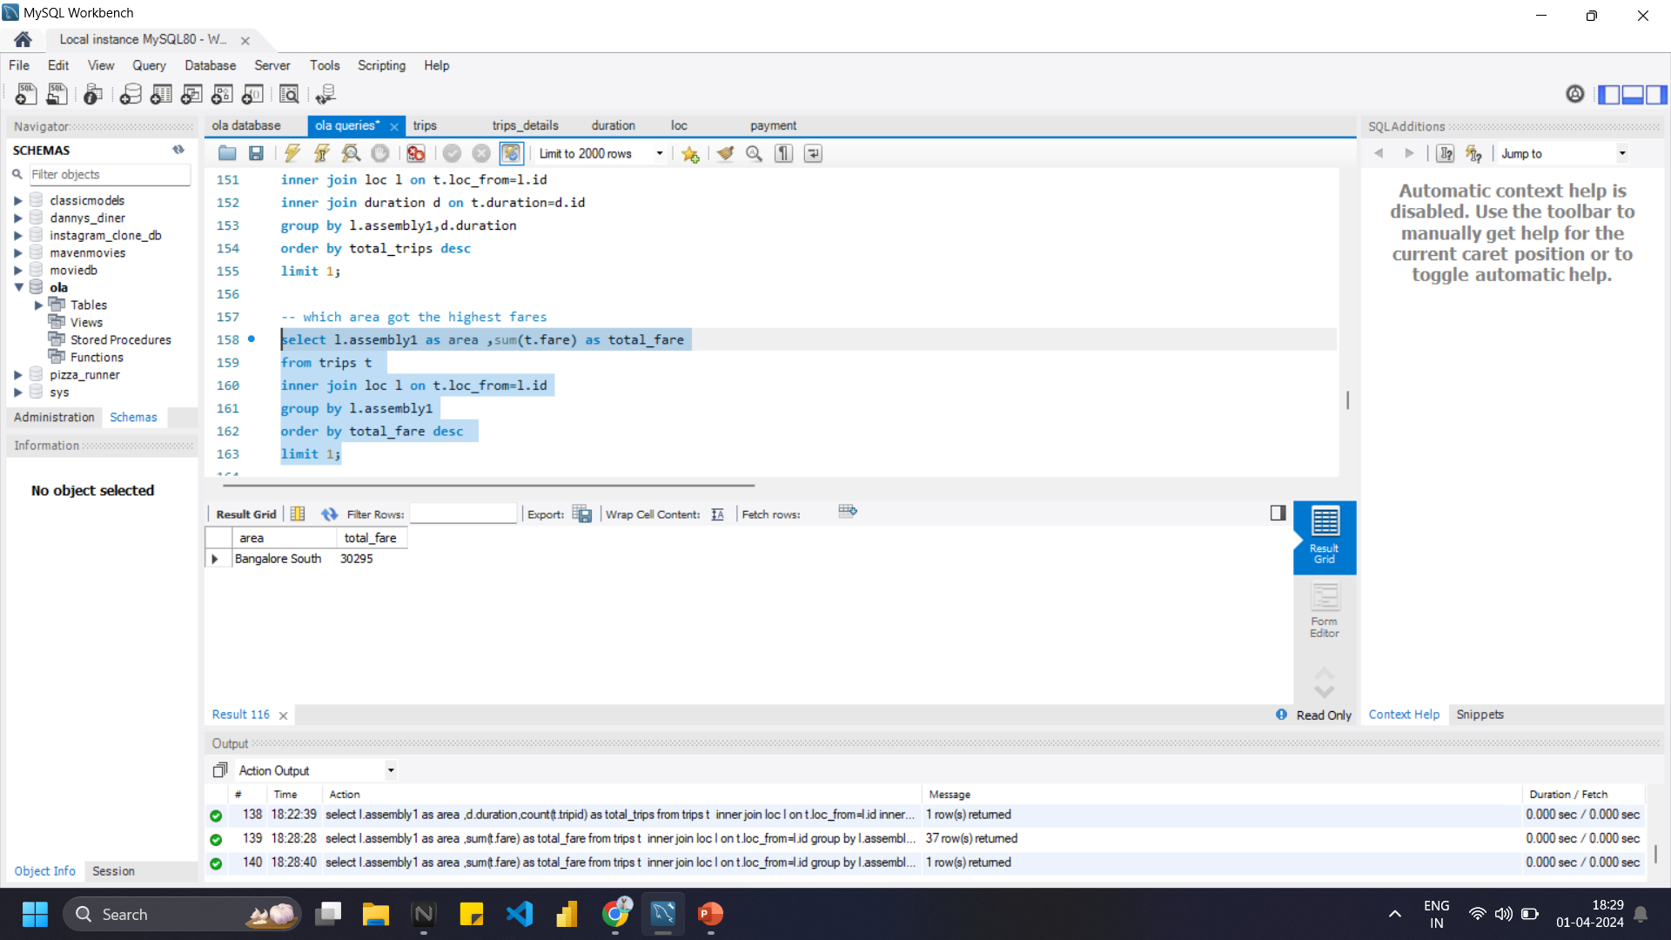
Write a SQL Query for , which area got the highest fares
Ans:
select l.assembly1 as area ,
sum(t.fare) as total_fare
from trips t
inner join loc l on t.loc_from=l.id
group by l.assembly1
order by total_fare desc
limit 1;

Slide 15
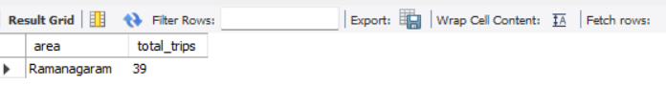
Write a SQL Query for , which area got the highest trips
Ans:
select l.assembly1 as area ,
count(t.tripid) as total_trips
from trips t
inner join loc l on t.loc_from=l.id
group by l.assembly1
order by total_trips desc
limit 1;

Slide 16
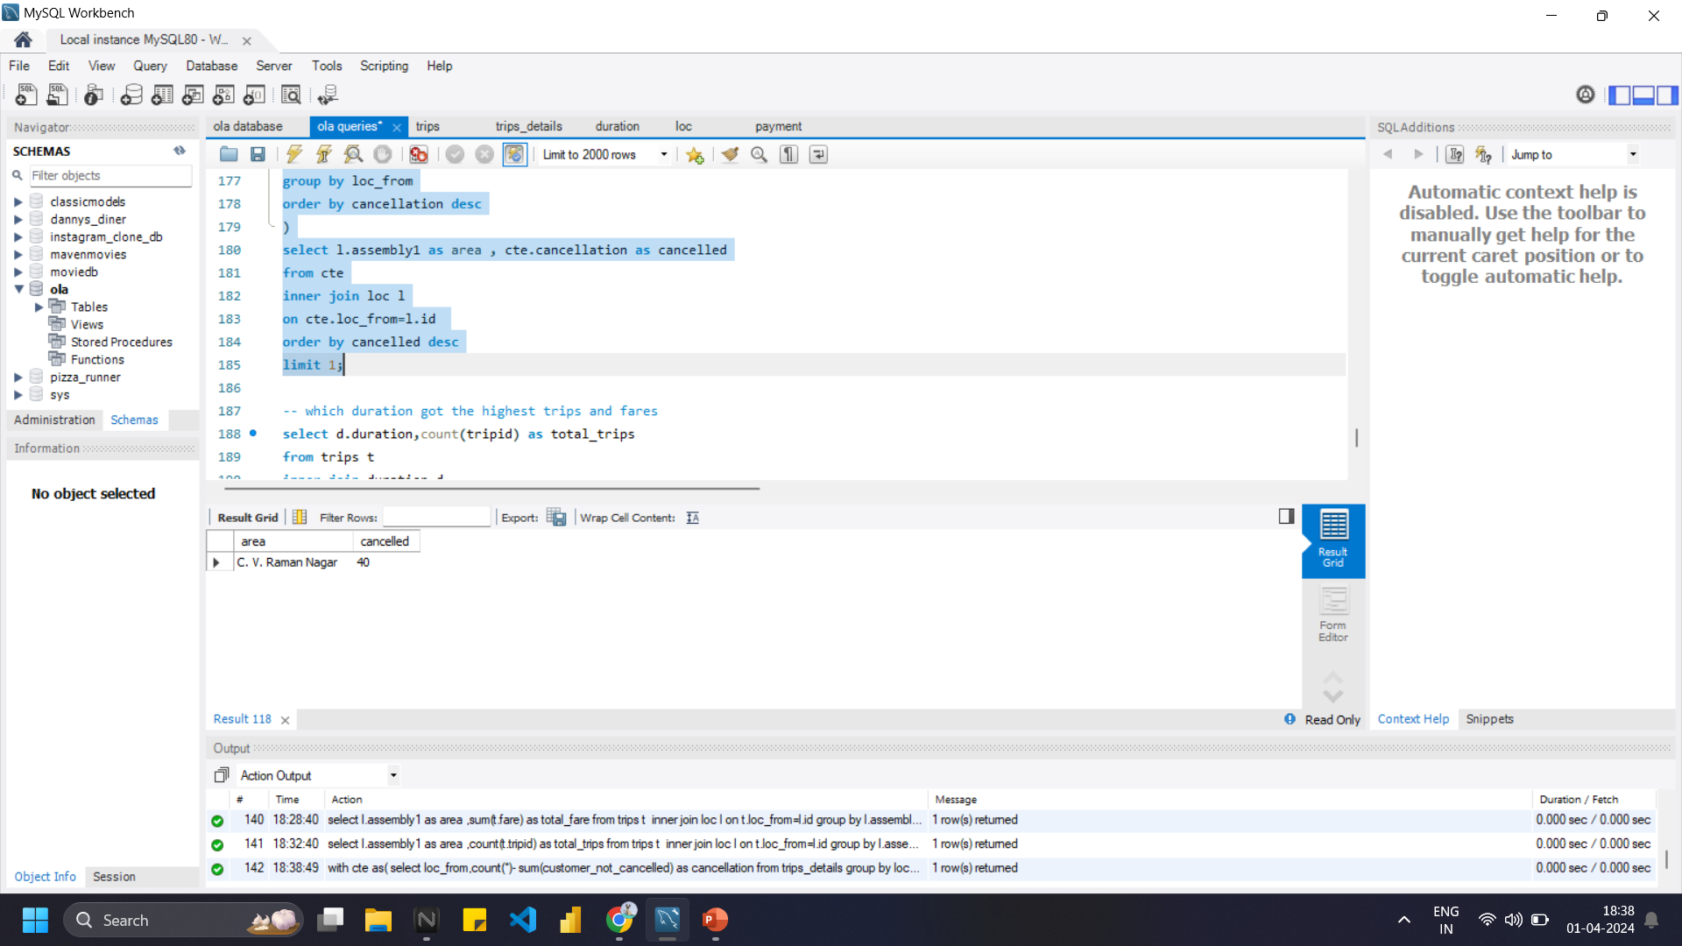
Write a SQL Query for , which area got the highest cancellation
Ans:
with cte as(
select loc_from,count(*)- sum(customer_not_cancelled) as cancellation
from trips_details
group by loc_from
order by cancellation desc)
select l.assembly1 as area , cte.cancellation as cancelled
from cte
inner join loc l on cte.loc_from=l.id
order by cancelled desc
limit 1;

Slide 17

Thank you

